Slide 1
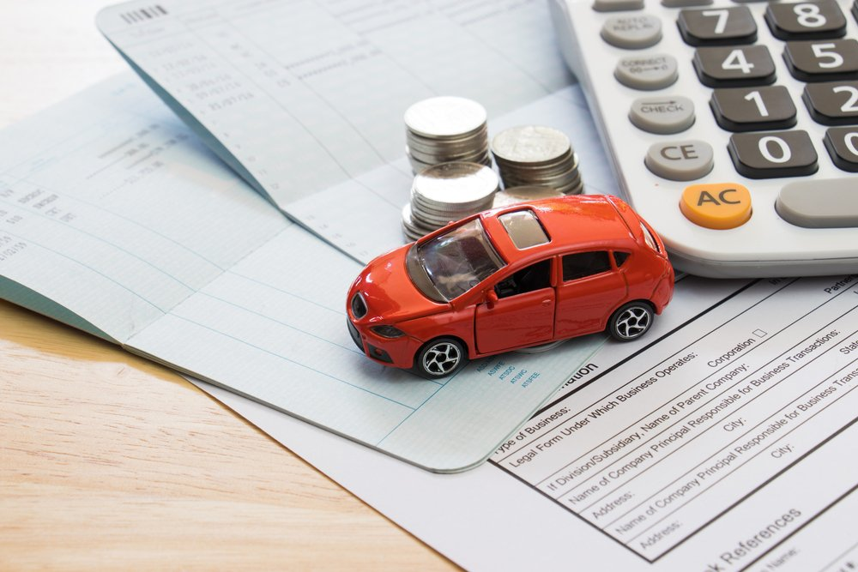
Solution for whether the car insurance claim should be passed or not using Bayesian Statistics?
Name: Ayush Manojkumar Lodha
Class Project: STAT 52900

Slide 2
Dataset Description & Problem Statement
Problem Statement: Should claim be passed on basis of 6 major variables ?
Major car insurance companies have this issue that whether the claim must be passed or not, the data driven decision would give them edge over their competitors and also satisfy their customers
Also it is interesting to know for the car owner what are the chances that my claim is passed ?
Source of Dataset: https://www.kaggle.com/code/kerneler/starter-car-insurance-claim-data-62f4f91c-d/data
This dataset of car insurance claim has originally two target variables
Binary variable: whether claim has passed (Yes or No)
This dataset originally have 25 variables for determining the two target variables
I have selected 6 major variables for analysis on this project and one target variable for whether claim has passed (Yes or No). I have shortlisted these on basis of following criteria.
The correlation among the variables should be low as possible.
Interesting variables should be included in the analysis to understand them

Slide 3


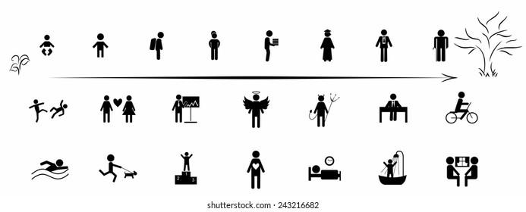



Problem Statement Description
Dependent: Binary Variable
Independent Variables:
Age
Income
Age of Car
Car insurance claim or not ?
YES:1(If claim is passed)😊
NO:0(If claim is not passed)😔
Travelling Time
Value of Car
Years on Job
Independent Variables | Description | Hypothesis (Hypothetical Effects/Presumptions)
AGE | Age of the Drive | Young Drivers tend to be more risky
INCOME | Income | High income people tend to have advanced cars.(general trend may not be true)
CAR_AGE | Age of Car | Newer cars have more safety features
TRAVTIME | Travelling Time (Distance to work) | Longer journey means chance of accident increases
BLUEBOOK | Value of Vehicle | This may effect the claim amount and hence related to claim must be passed or nt
YOJ | Years on Job | More the time spend on job, more they drive safely usually

Slide 4
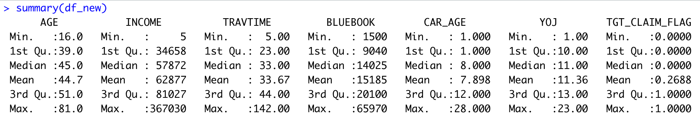
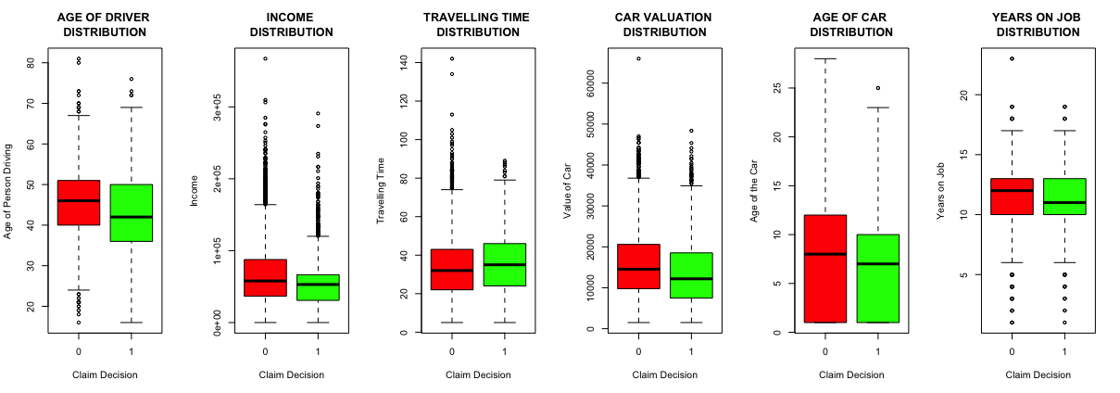
Preprocessing of Dataset
Cleaning the dataset: Drop the duplicate rows.
Replace null values by interpolation and mean values of the Data.
Summary Statistics
Boxplots
Removed outliers from the data after this step!

Slide 5
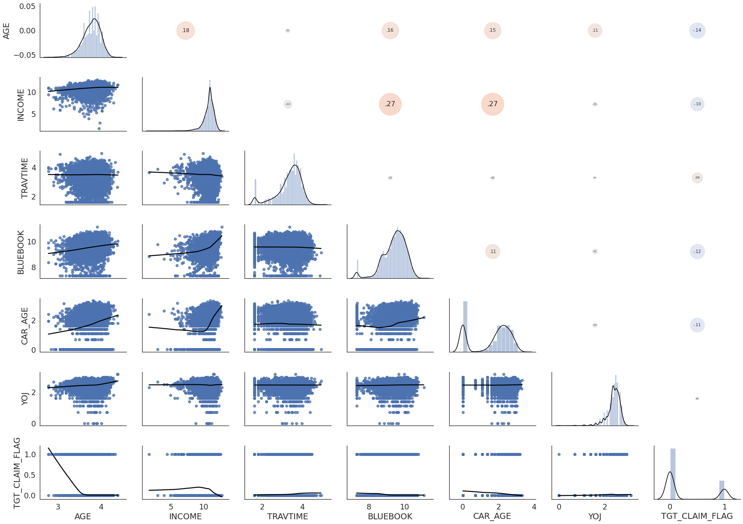
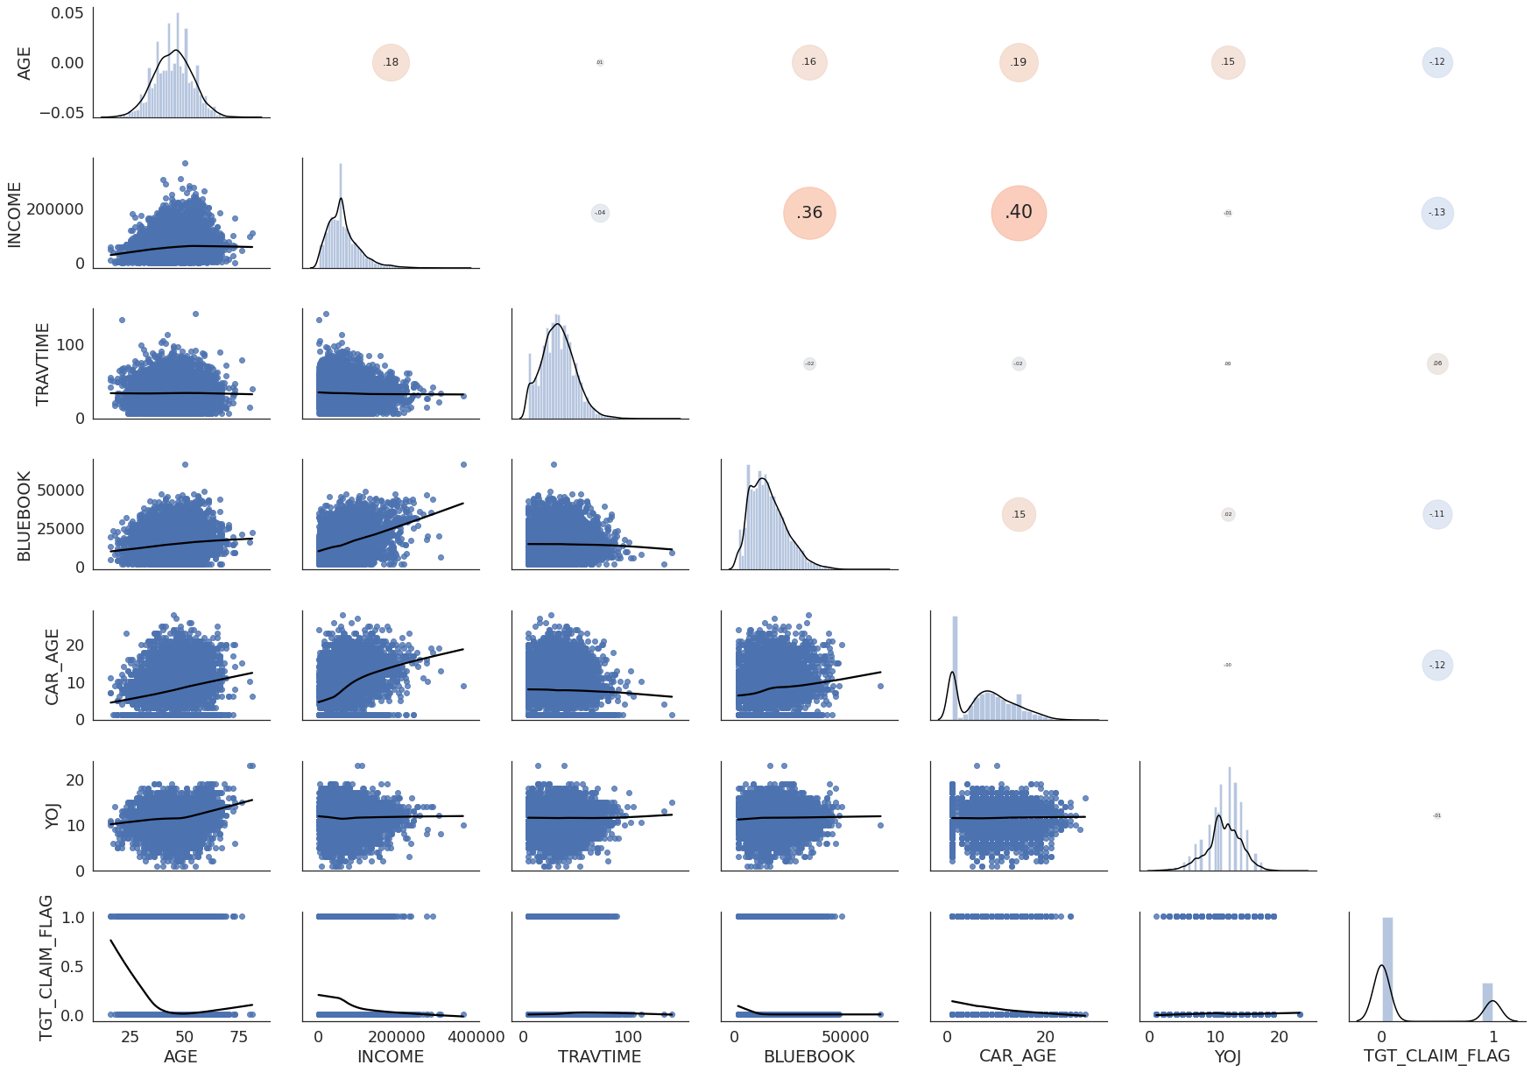
Pairplots,Histogram and Correlation matrix
Log Transform
We use log transform to fix the skewness of the dataset.
There are significant instances in which claims are passed or not, hence there is no need to do any kind of under-sampling or over-sampling to balance the instances in dataset.

Slide 6
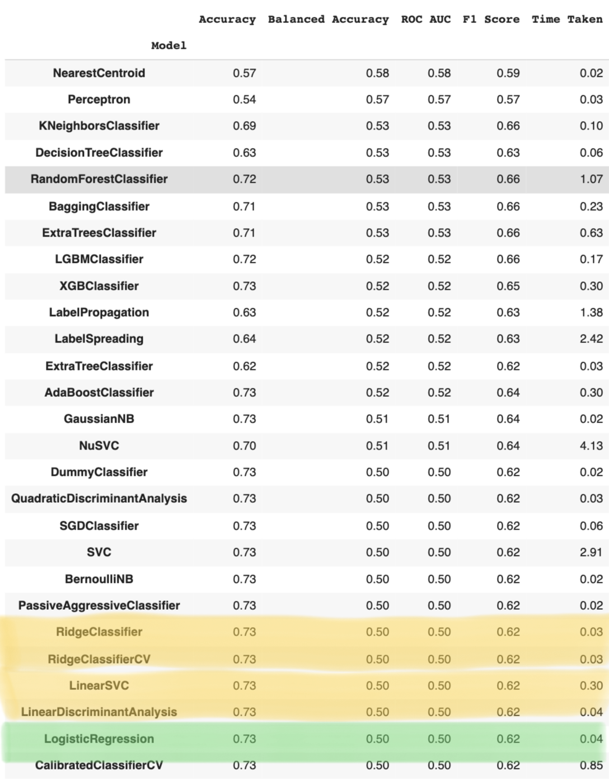

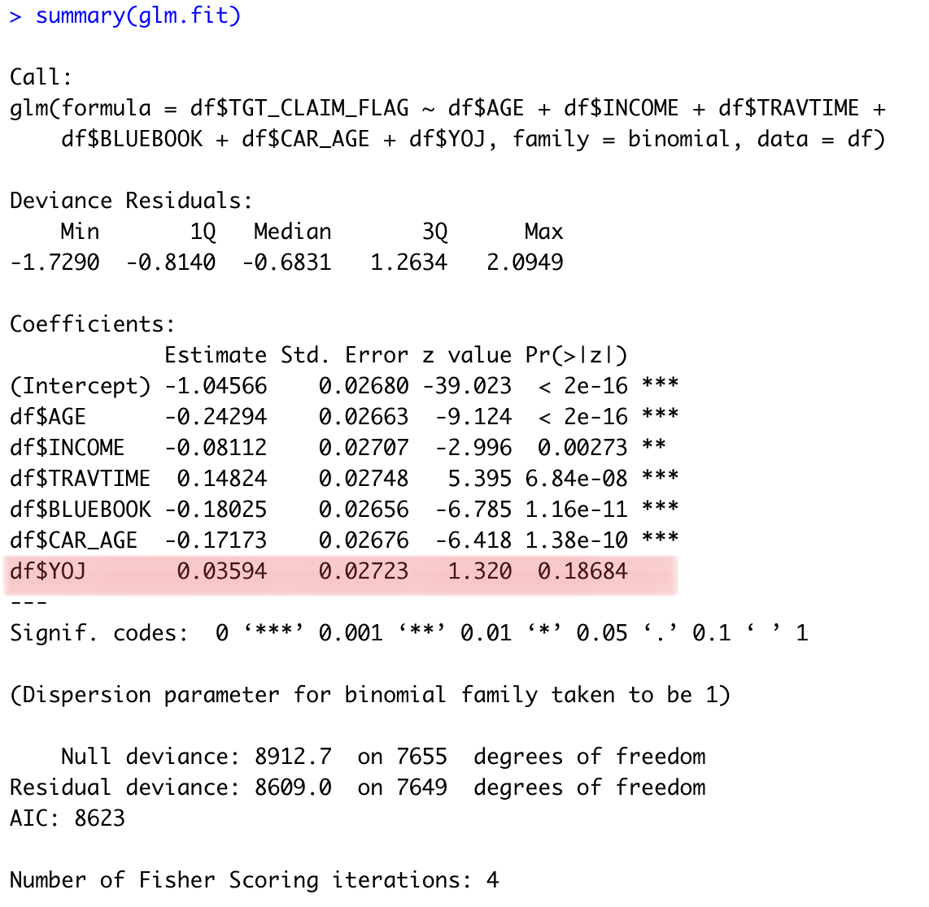
Preprocessed data into various model to obtain baseline results
Run all the know modelling types to compare our Bayesian analysis results with them.
We choose our Baseline model to be Logistic Regression and obtain the following results from it.
Here we can see that from p-value test that YOJ should be removed from the model. But we discuss this more in upcoming slides.

Slide 7
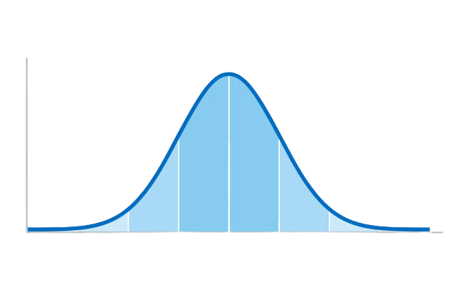
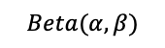
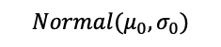
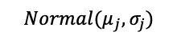



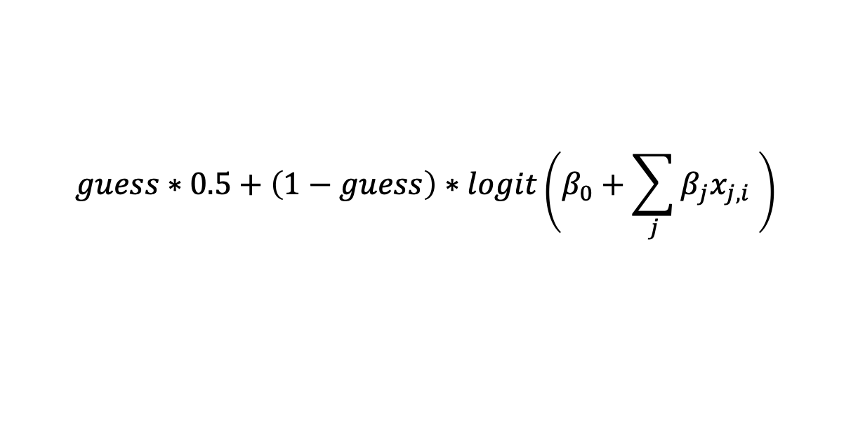
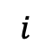
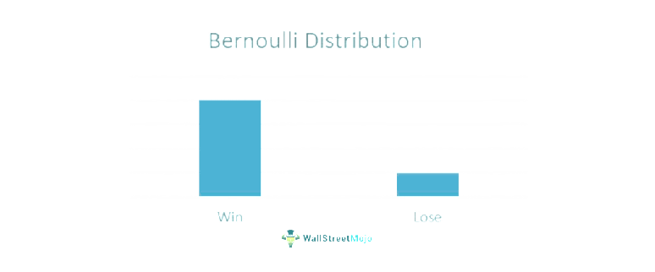
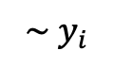
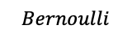
Proposed Model during the Midterm Presentation
Since we previously had many outliers in the dataset, we assumed the guess parameter in the proposed model to be non-zero and hence we took the prior as Beta model.
But now in our data cleaning and preprocessing steps we have removed all the outliers from the data, hence we can tell that guess parameter is zero.

Slide 8
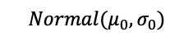
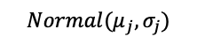


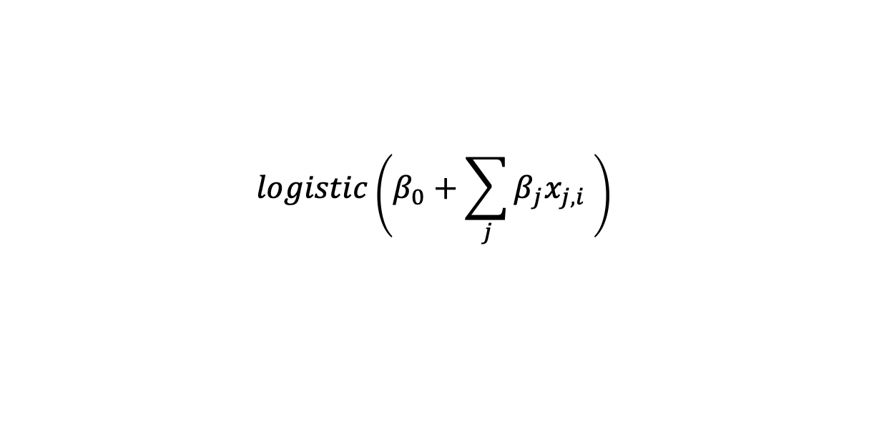
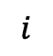
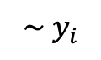
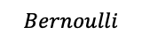
Updated Model 1

Slide 9
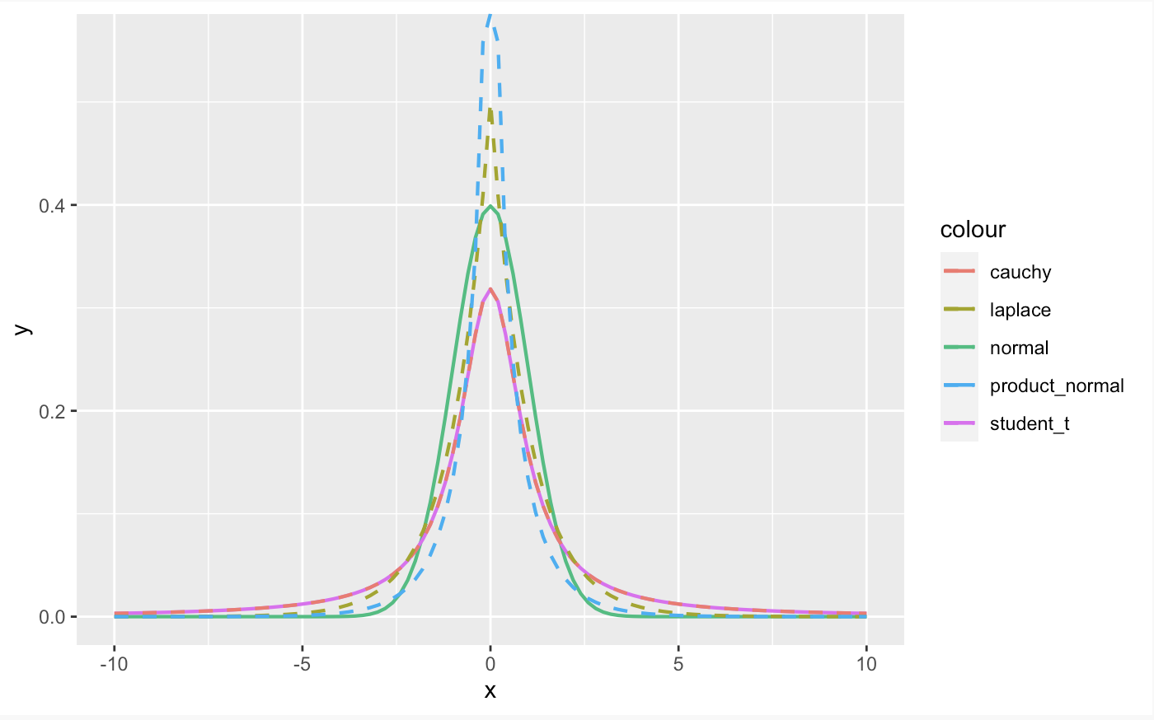
Comparision of Prior Distribution
In the family of Binomial Logistic Bayesian Classification Model, we choose Normal and Student_t distribution for our Bayesian analysis.
References:https://mc-stan.org/rstanarm/reference/priors.html

Slide 10
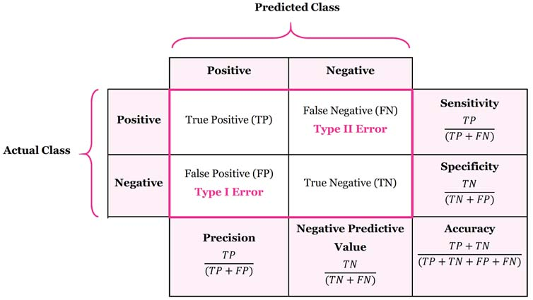
Confusion Matrix

Slide 11
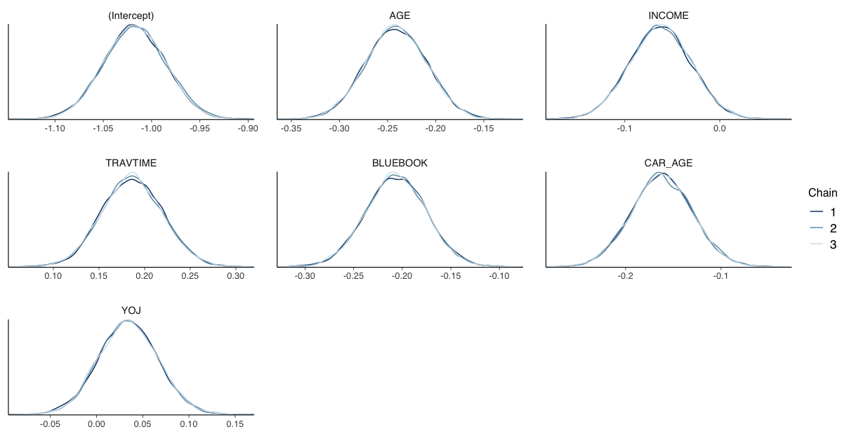
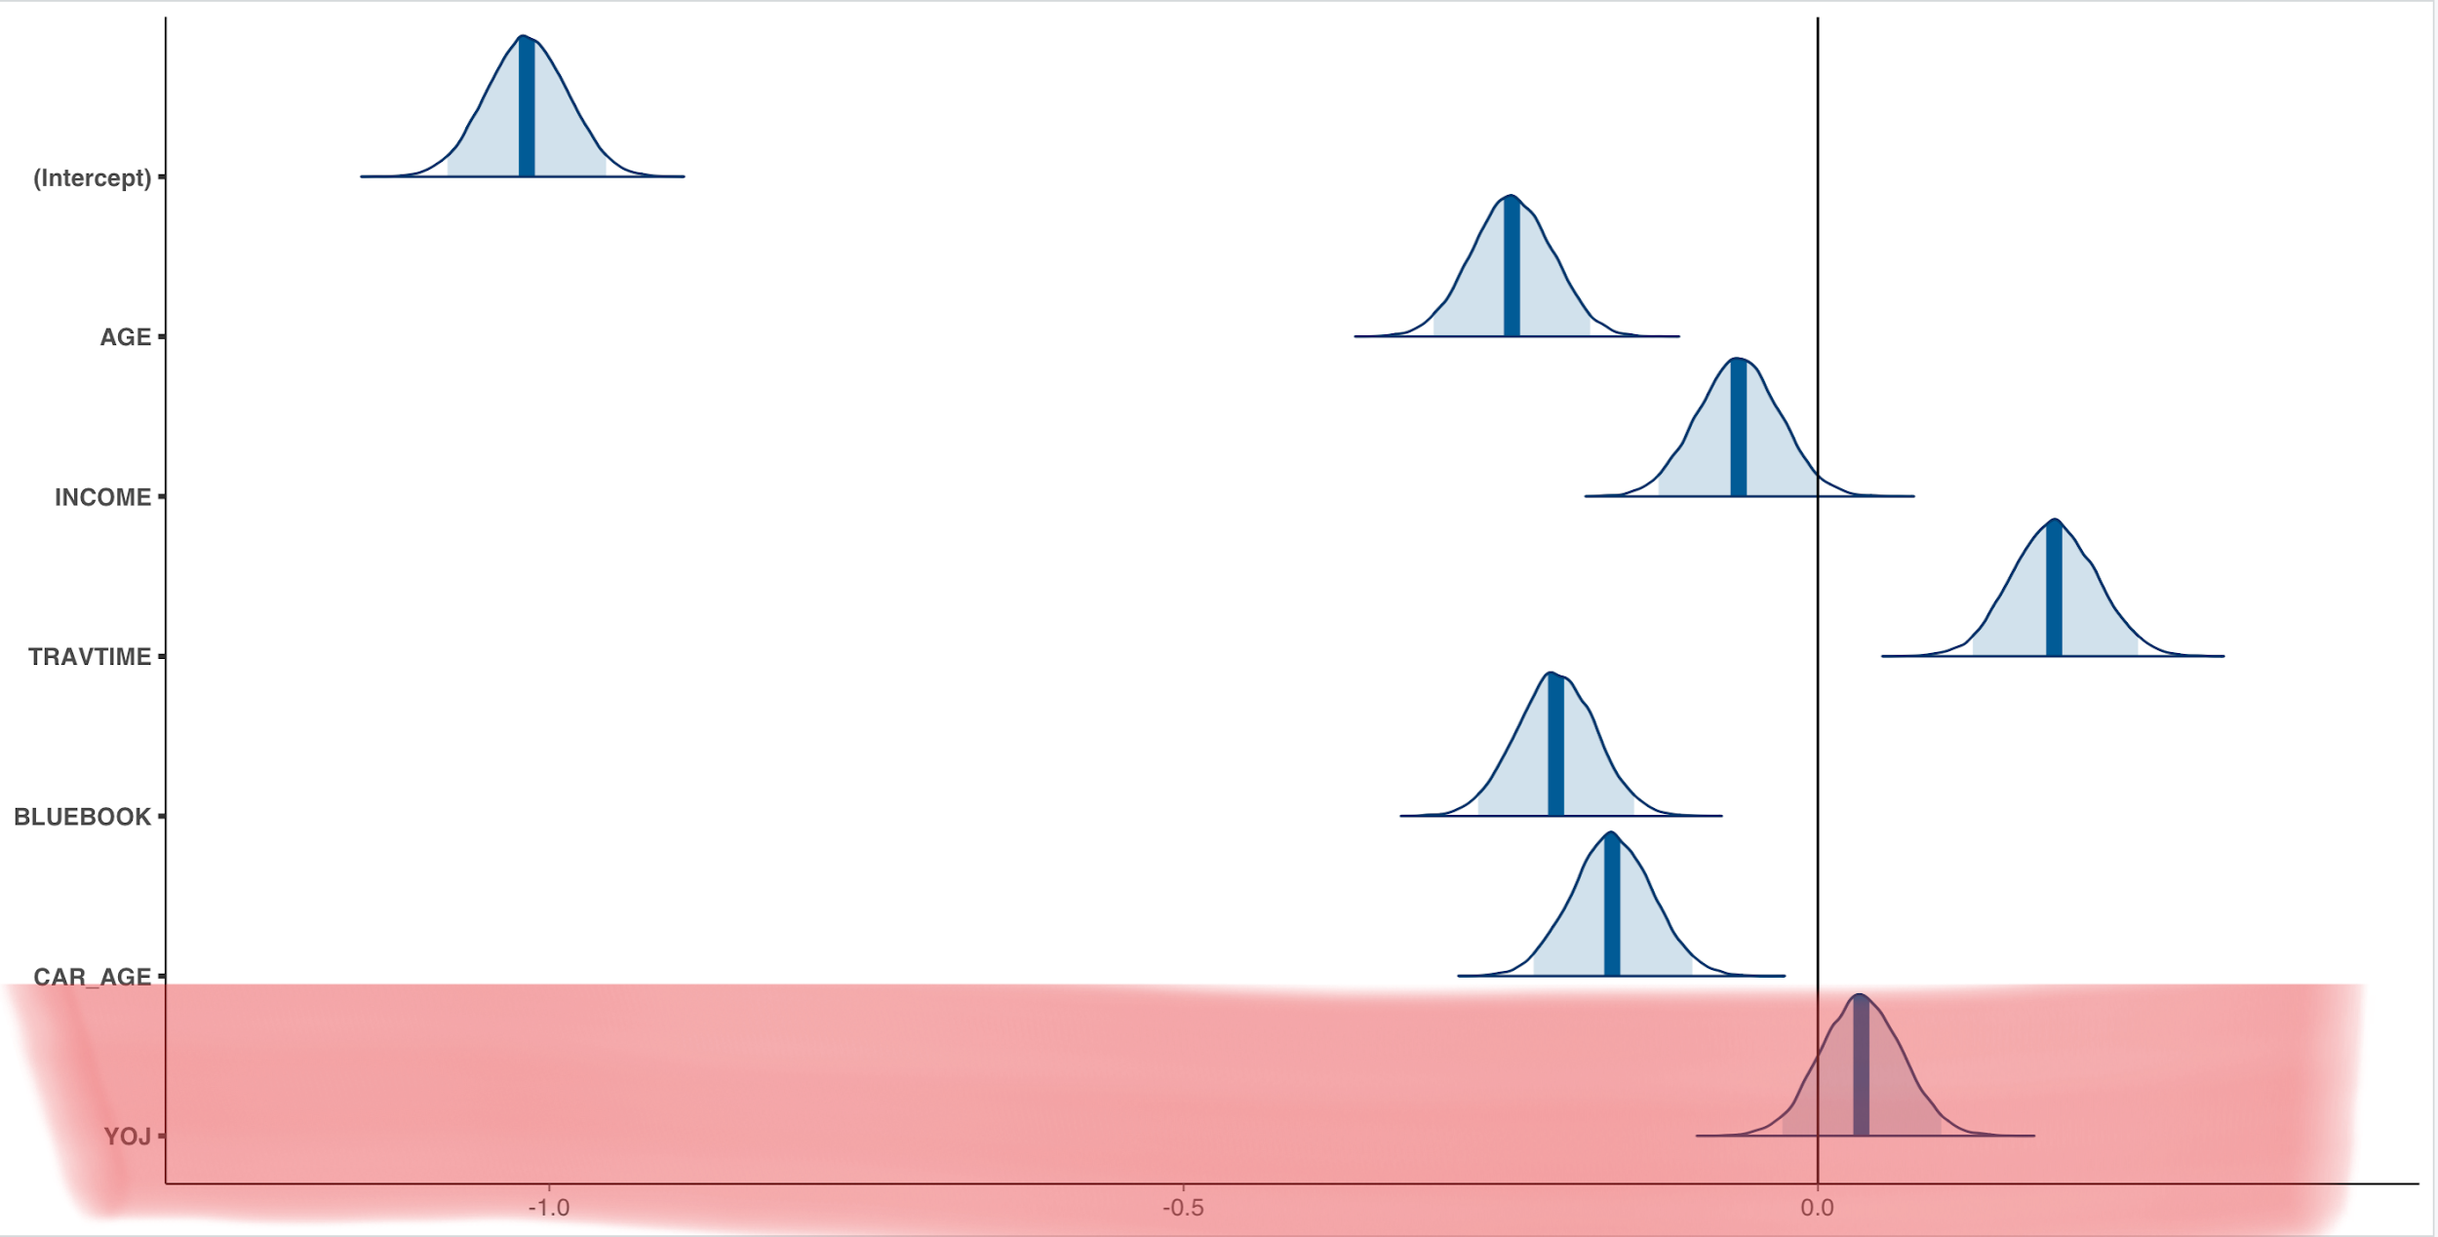
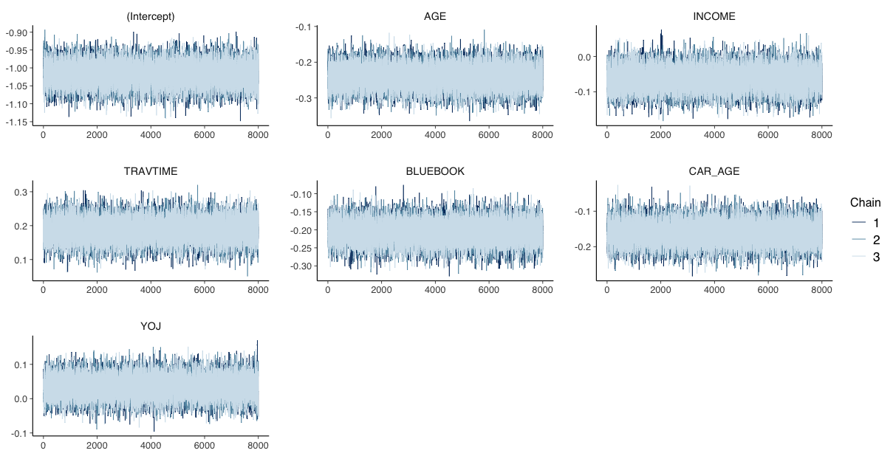
Results of Model1
Settings of Model 1:
Normal Uninformative Priors for this models choosen are as follows:
No of Iterations:50,000
Warmup/Burnin Period:10,000
Thinning Steps: 5; Chains=3

Slide 12
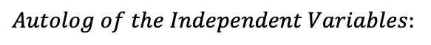
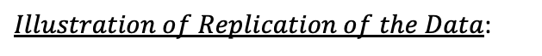
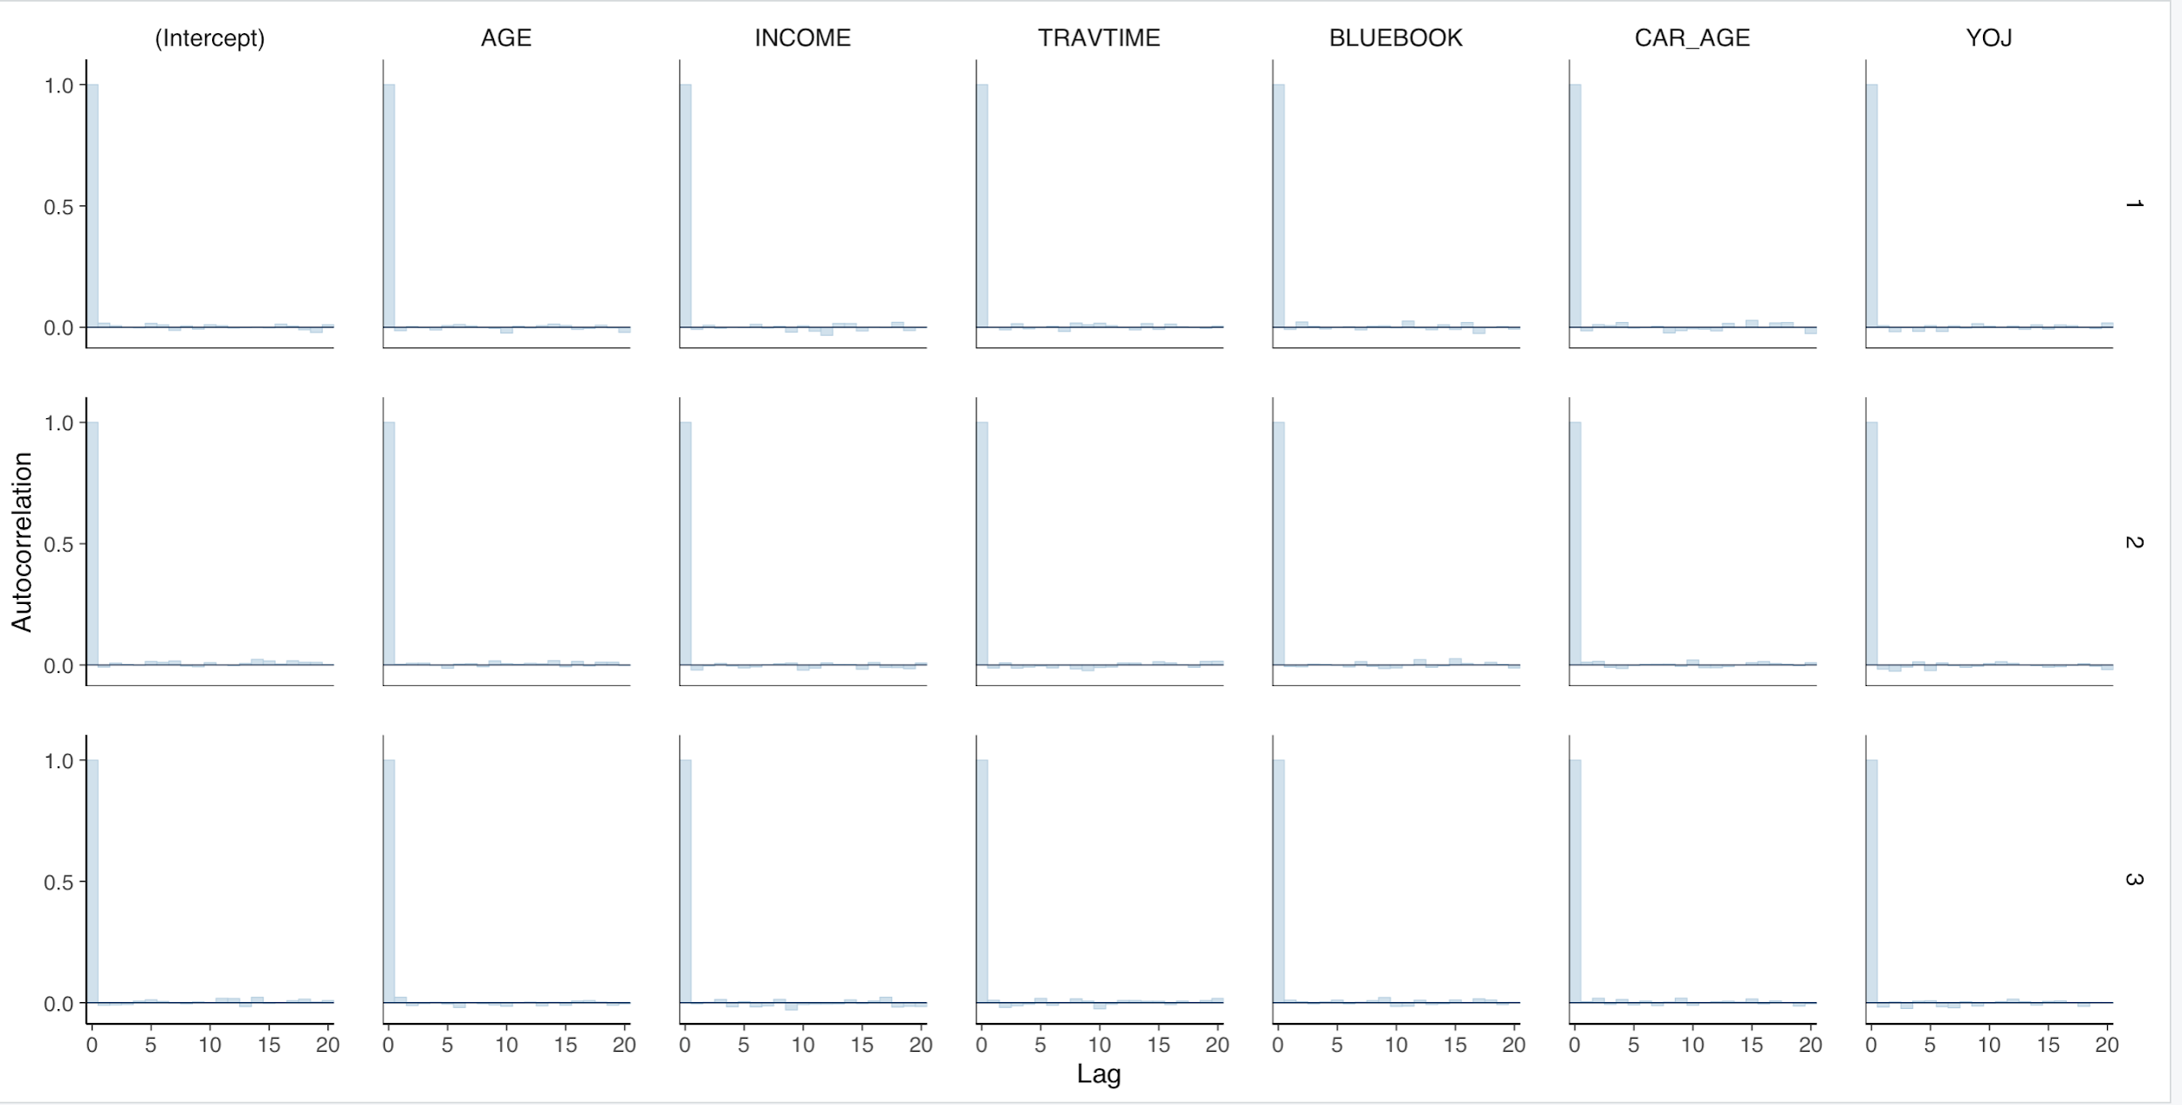
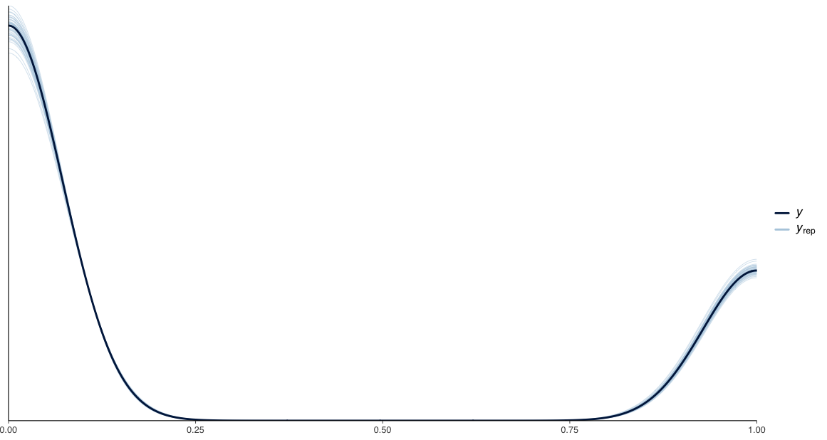
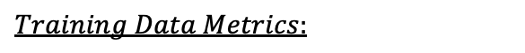
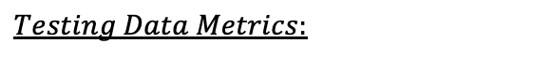
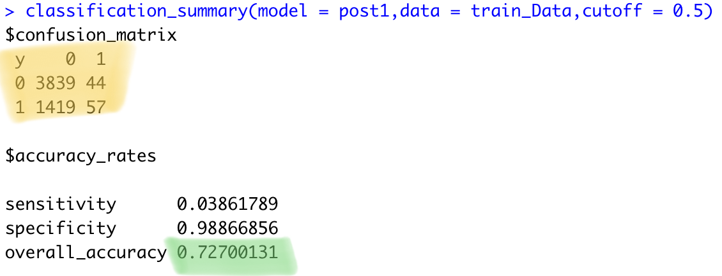
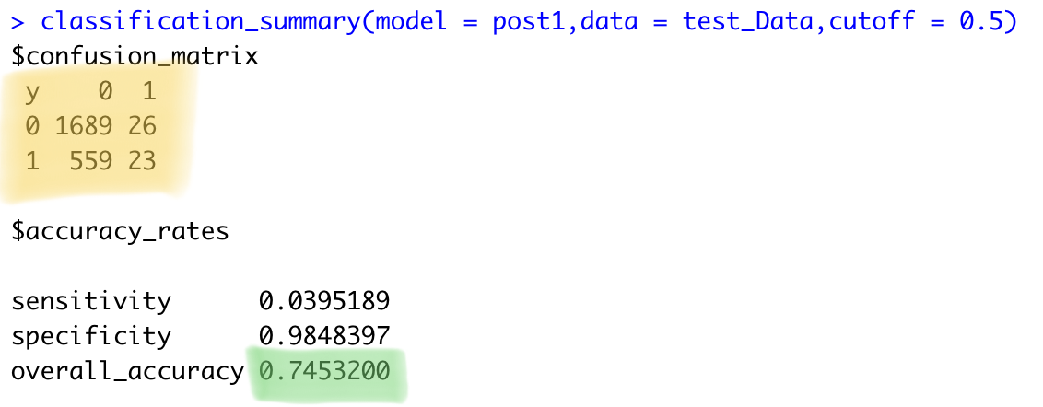
Results of Model1(continue)

Slide 13
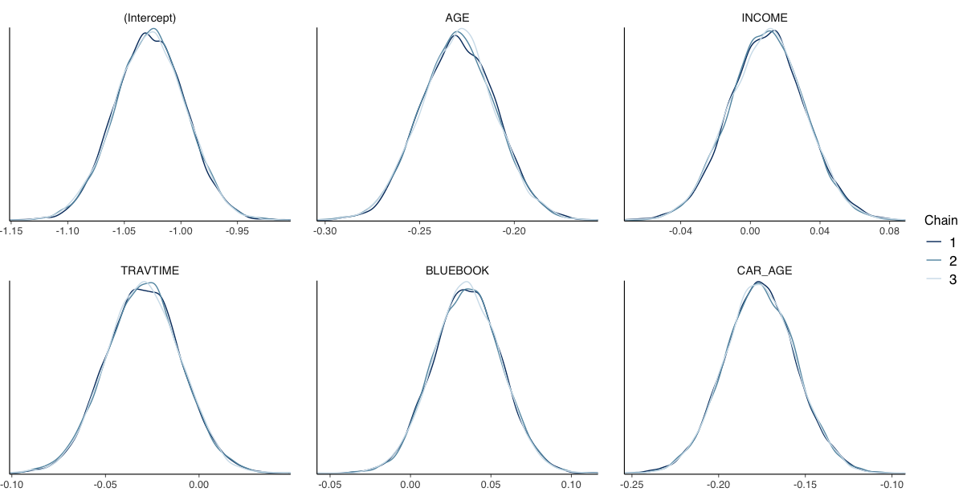
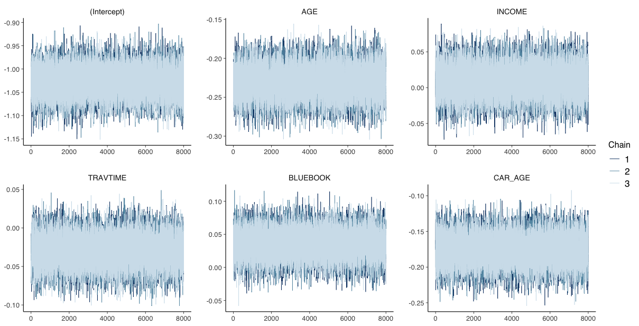
Results of Model2(Using the informative priors from Logistic Regression)
Settings of Model 1:
Normal Informative Priors for this models choosen are as follows:
No of Iterations:50,000
Warmup/Burnin Period:10,000
Thinning Steps: 5; Chains=3

Slide 14
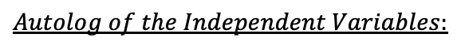
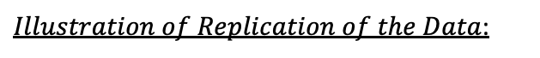
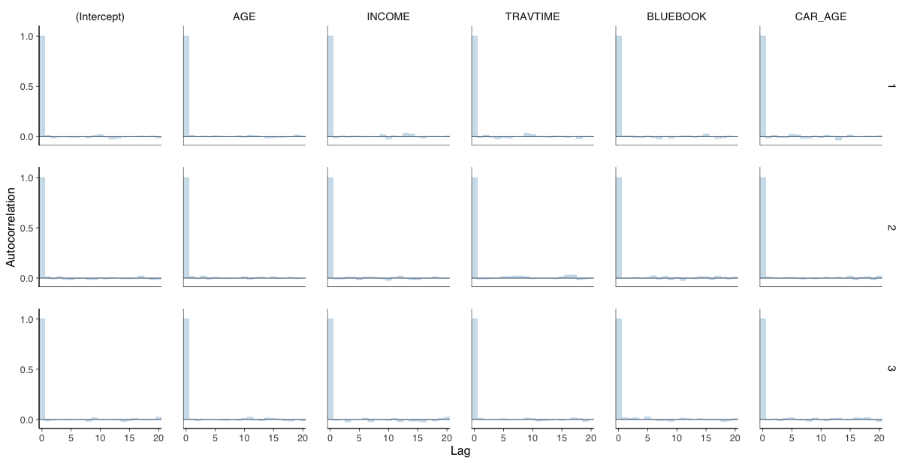
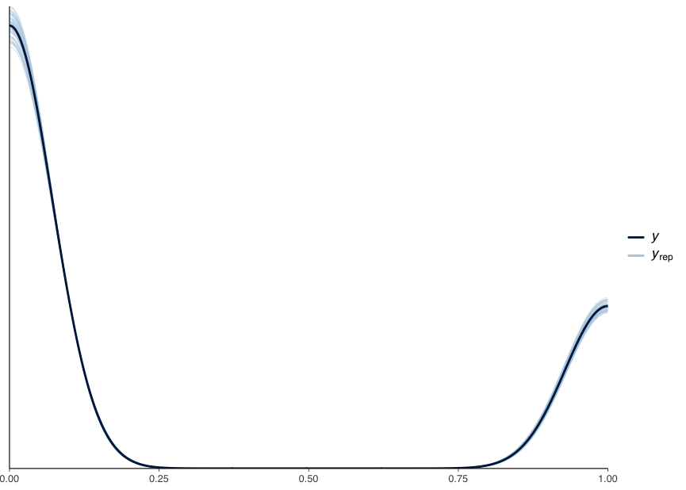
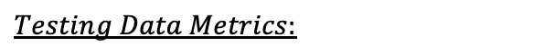
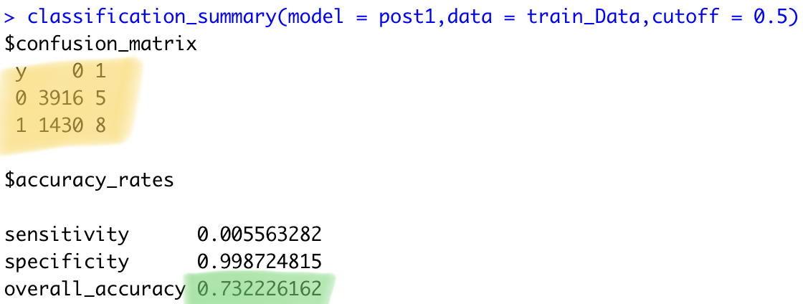
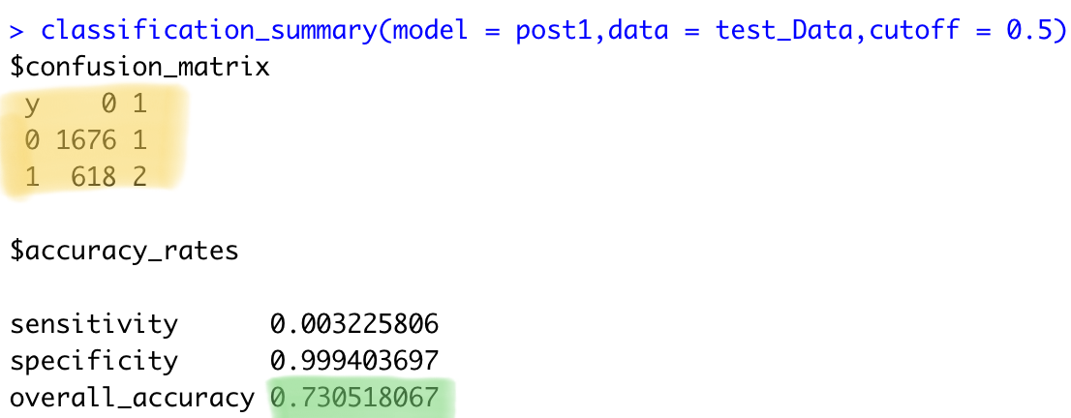
Results of Model2(continued)

Slide 15
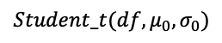
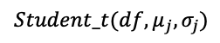
Model 3

Slide 16
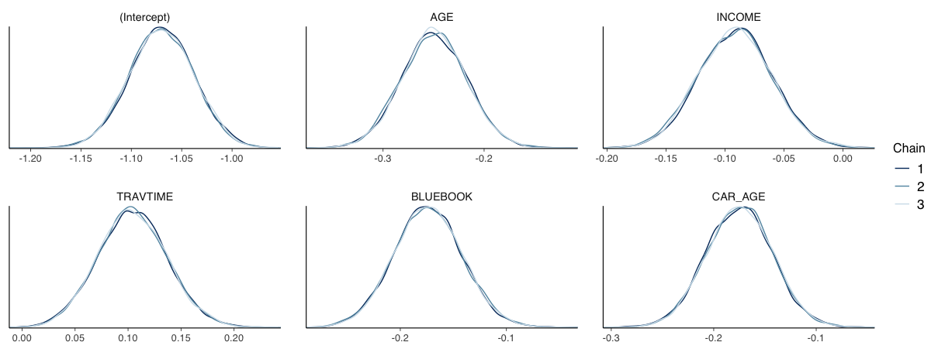
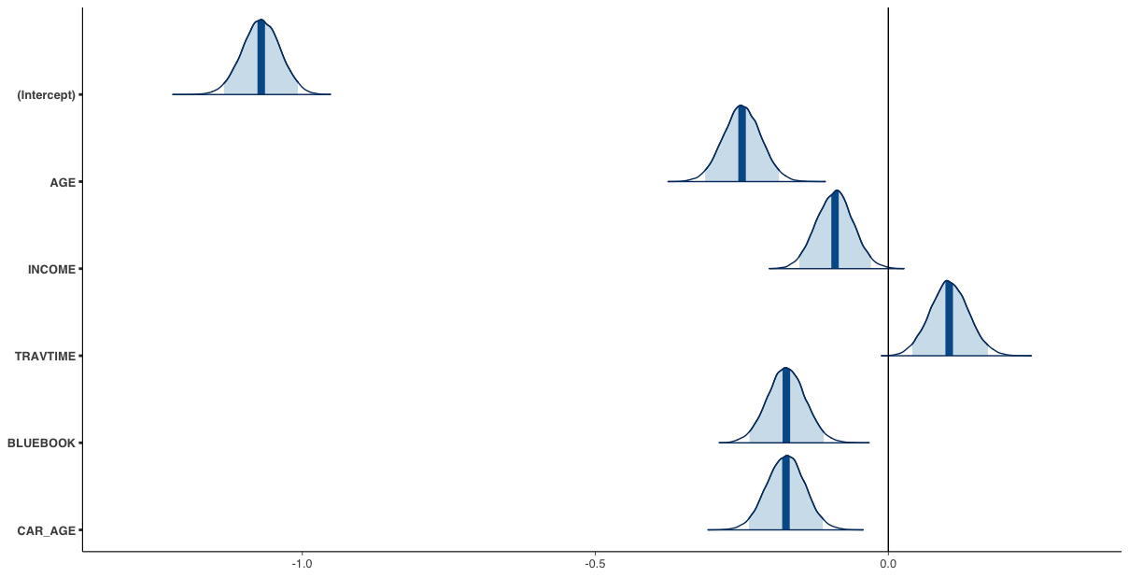
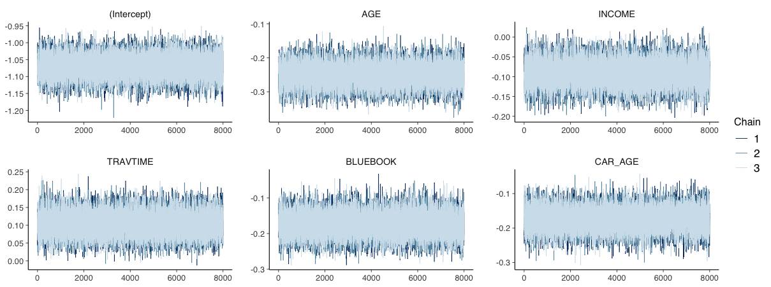
Results of Model3
Settings of Model 1:
Student_t Uninformative Priors for this models choosen are as follows:
No of Iterations:50,000
Warmup/Burnin Period:10,000
Thinning Steps: 5; Chains=3

Slide 17






Results of Model3(continued)

Slide 18



Results of Model4
Settings of Model 4:
Student_t Uninformative Priors for this models choosen are as follows:
No of Iterations:50,000
Warmup/Burnin Period:10,000
Thinning Steps: 5; Chains=3

Slide 19





Results of Model4(continued)

Slide 20
Conclusions.
Model | Prior | Prior Type | Accuracy | Confusion Matrix
Baseline Logistic Regression | - | - | 0.73
Model 1 | Uninformative | Normal | 0.7453
Model 2 | Informative | Normal | 0.7305
Model 3 | Uninformative | Student_t | 0.7226
Model 4 | Informative | Student_t | 0.7370
Learnings.
Bayesian Models are sensitive to the choice of priors.
Sometimes these uninformative priors are better than using informative once, because we bias ourselves by using informative, they should be taken from some previous studies and information available from domain experts.
Uninformative works very well but with slight restriction over type of distribution and spread of the variance.
Thinning Steps and Burn In steps are the important parameters in MCMC diagnosis because it would eventually decide the no of iterations which will directly affect the posterior distribution, which is our main focus during Bayesian analysis.
Whenever we deal with real world dataset, it comes lots of bias, which require extensive work over removing outliers without actual losing any critical information from data. Important steps of data cleaning and data preprocessing should not be missed and should be done thoroughly otherwise there can be mistakes in assumptions of the model.

Slide 21


Slide 22
References:
Thank You!
Any Questions?
https://avehtari.github.io/modelselection/diabetes.html
https://www.bayesrulesbook.com/chapter-13.html
https://www.rdocumentation.org/packages/rstanarm/versions/2.21.3/topics/stan_glm
https://www.kaggle.com/code/kerneler/starter-car-insurance-claim-data-62f4f91c-d/comments
https://www.kaggle.com/code/kerneler/starter-car-insurance-claim-data-62f4f91c-d/comments
https://www.kaggle.com/code/dllim1/end-to-end-ml-on-motor-insurance-with-xgboost
https://hbiostat.org/doc/rms/lrm-brms.pdf
https://www.statology.org/confusion-matrix-in-r/
Bayesian Logistic Regression Modelfor Credit Score Data-Presented by Hongfei Li, Lai Wei

